Slide 1
HOME
ABOUT
GAMES
GAMINFORG.COM
Trending games:
Game 1
Game 2
Tips and tricks for the games. The arrows alternate between games, with pictures in the background.
<
>

Slide 2


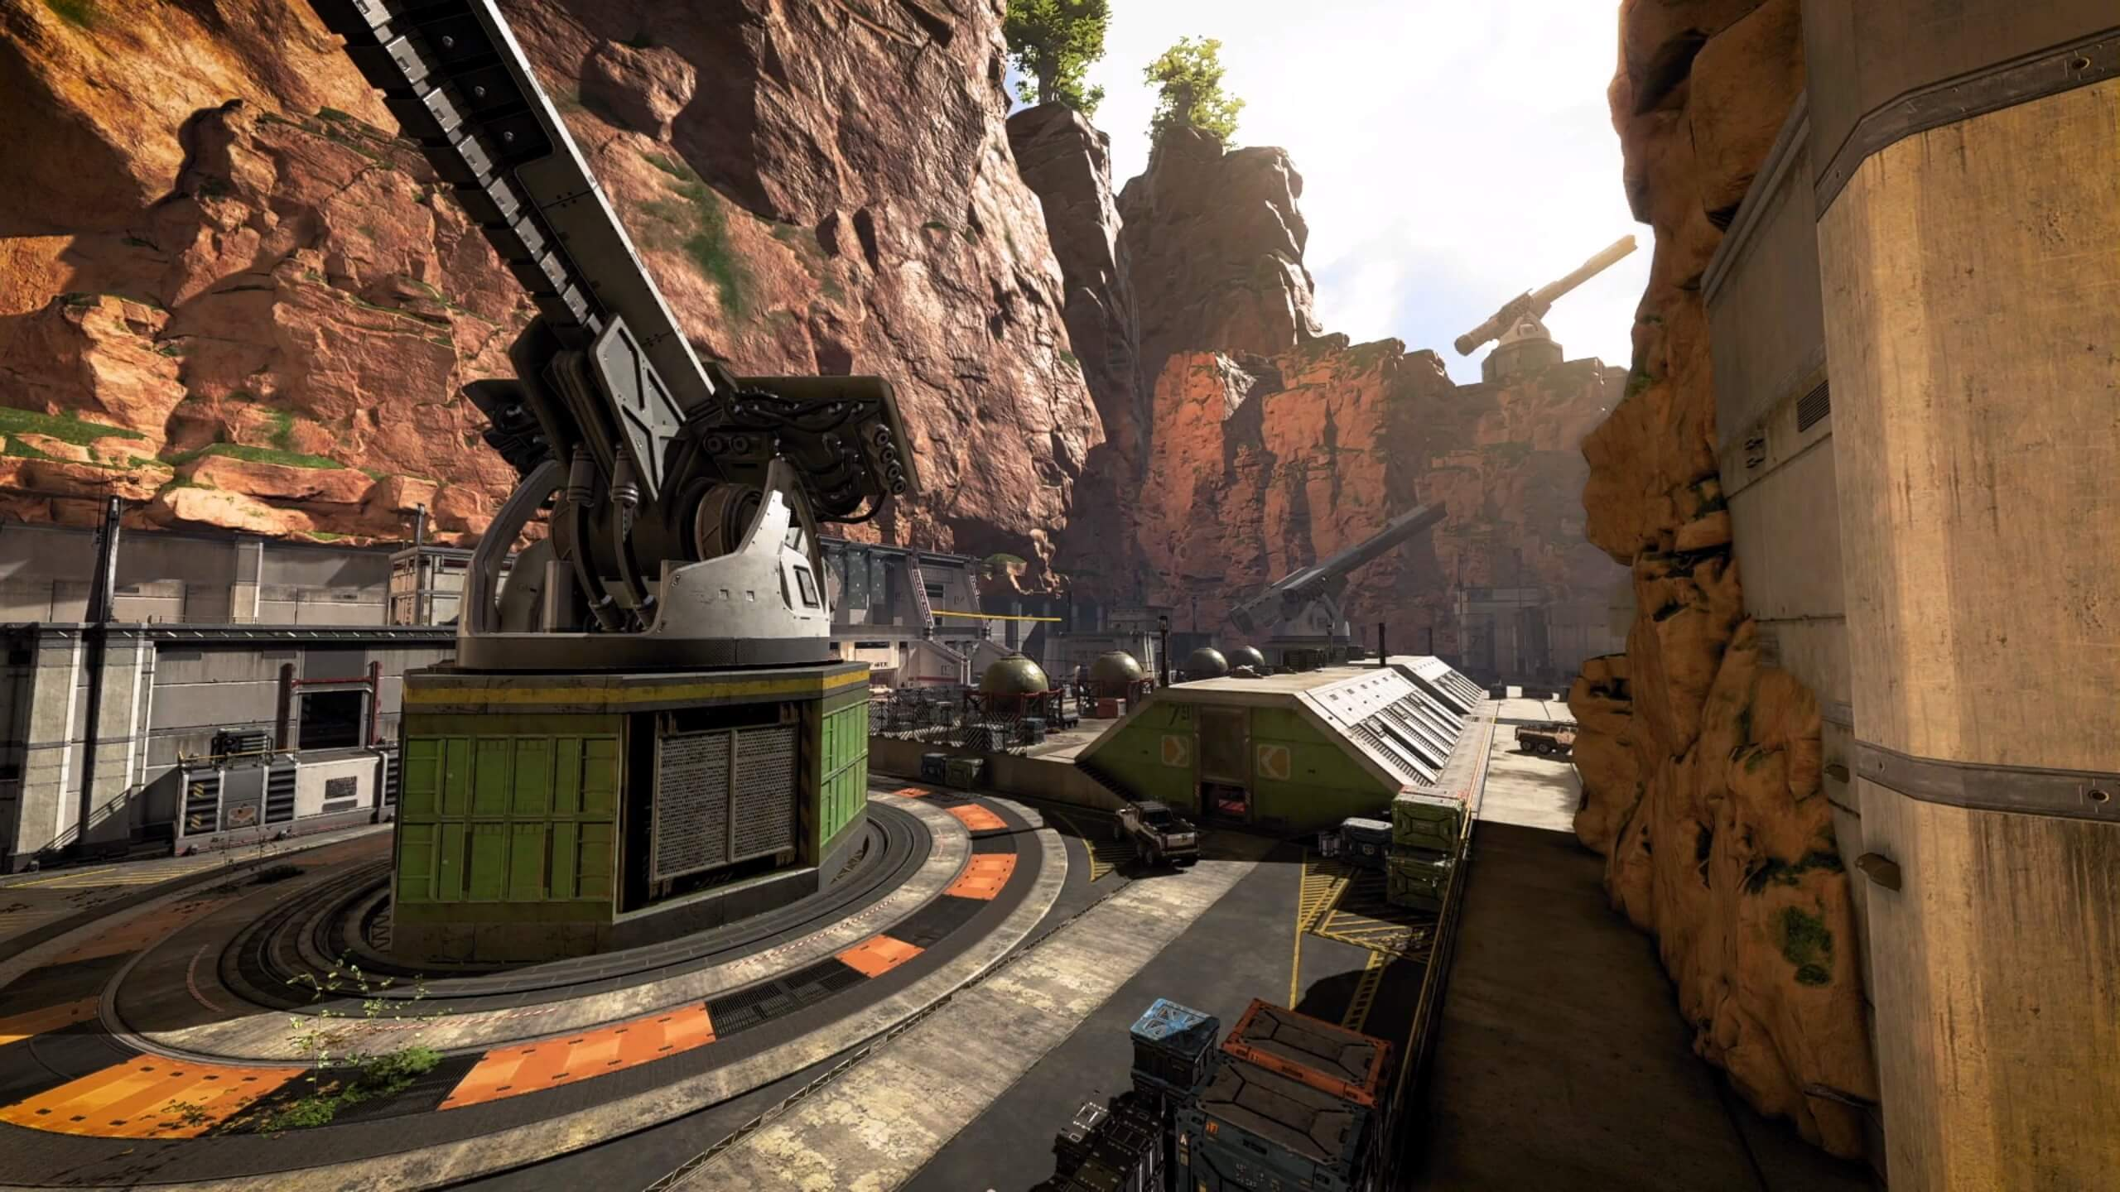
ABOUT US
LOCATIONS
GAMINFORG.COM
TRENDING NOW
APEX LEGENDS
CALL OF DUTY: VANGUARD
KEEP AN EYE ON THE RING:
Never forget to constantly check your map and make sure you are always moving towards the center
<
KEEP AN EYE ON THE RING:
Never forget to constantly check your map and make sure you are always moving towards the center
>

Slide 3

ABOUT US
LOCATIONS
GAMINFORG.COM
TRENDING NOW
APEX LEGENDS
CALL OF DUTY: VANGUARD
KEEP AN EYE ON THE RING:
Never forget to constantly check your map and make sure you are always moving towards the center
<
KEEP AN EYE ON THE RING:
Never forget to constantly check your map and make sure you are always moving towards the center
>

Slide 4

ABOUT US
LOCATIONS
GAMINFORG.COM
TRENDING NOW
APEX LEGENDS
CALL OF DUTY: VANGUARD
KEEP AN EYE ON THE RING:
Never forget to constantly check your map and make sure you are always moving towards the center
<
KEEP AN EYE ON THE RING:
Never forget to constantly check your map and make sure you are always moving towards the center
>

Slide 5

ABOUT US
LOCATIONS
GAMINFORG.COM
TRENDING NOW
APEX LEGENDS
CALL OF DUTY: VANGUARD
KEEP AN EYE ON THE RING:
Never forget to constantly check your map and make sure you are always moving towards the center
<
KEEP AN EYE ON THE RING:
Never forget to constantly check your map and make sure you are always moving towards the center
>

Slide 6
Game 1
GAME 2
FAQ
FAQ

Slide 7

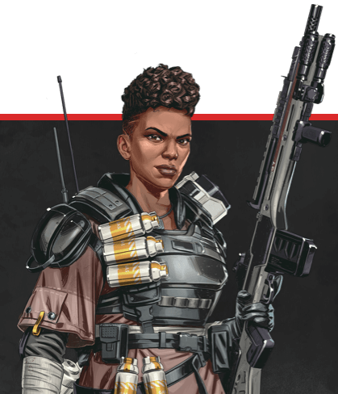


FAQ’s
scroll to top

Slide 8
FAQ’s
scroll to top

Slide 9
FAQ’s
scroll to top

Slide 10
FAQ’s
scroll to top

